Slide 1

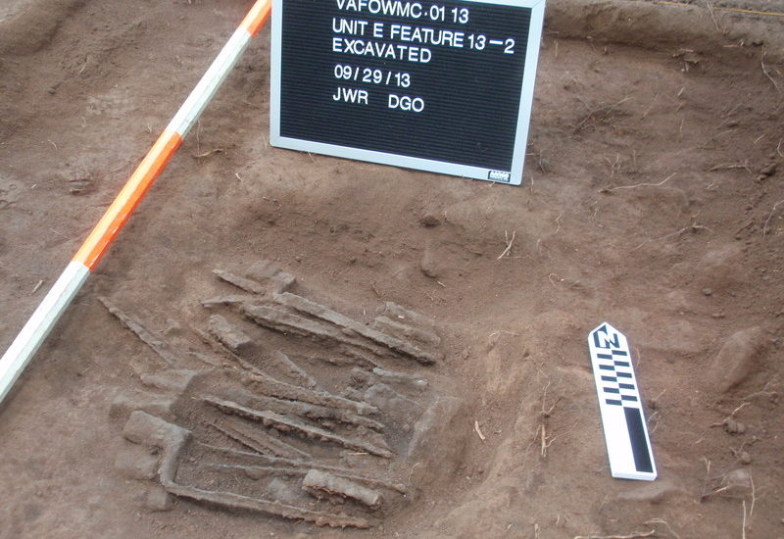
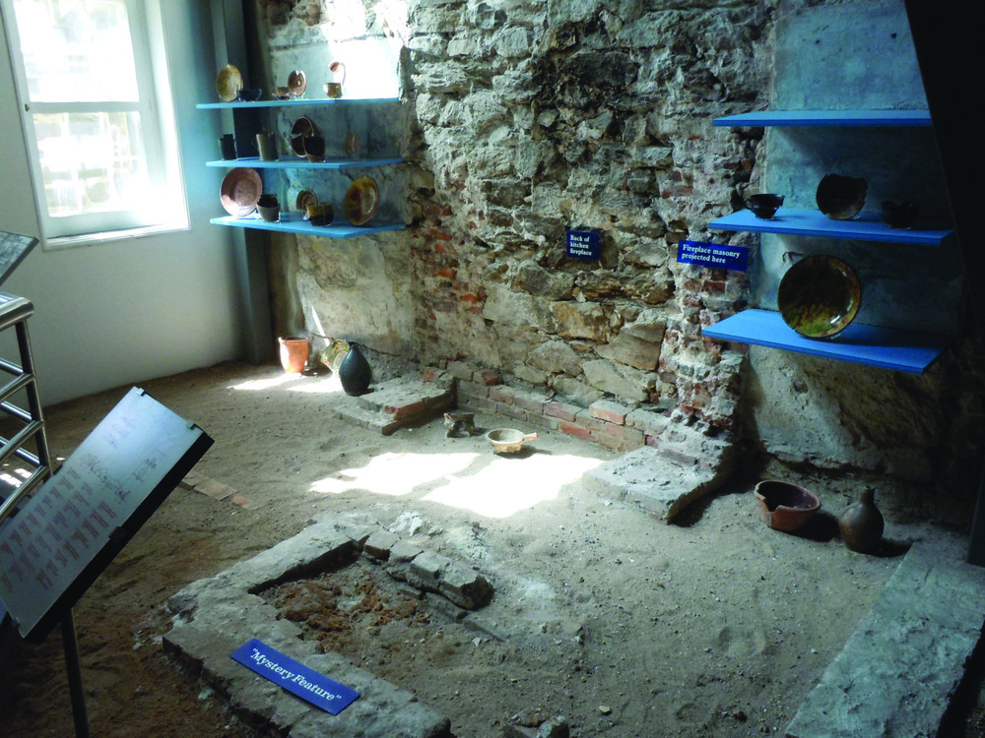
Please Join Us for the 2026 SPA Summer Field Trip “Exploring Revolutionary War Archaeology” July 16-19, 2026
https://montco.today/2025/11/archaeology-student-writes-dissertation-bayonet-stash-unearthed-valley-forge/
https://www.nps.gov/media/photo/gallery-item.htm?pg=4061328&id=3e35b149-155d-451f-67f1-8b88a86a9a5b&gid=3CFB1BE1-155D-451F-6700CAB497CC630F
This year, as our nation marks 250 years, we will be learning about the archaeology of the Revolutionary War in the Philadelphia area. This is going to be another fabulous trip which you don’t want to miss! We have tours and lectures planned at the Museum of the American Revolution, Independence National Historical Park, Fort Mifflin, Washington Crossing Historic Park and Valley Forge National Historical Park. Registration is now available on the SPA website and will also be possible at Annual Meeting April 11-12. Information is being distributed to SPA Chapters as well. We are planning a bus trip again, and the SPA fee which is $450/per SPA member (or member’s guest) will take care of the bus rental, lunches, and one group dinner as well as any entrance, tour, and speaker fees. Participants will book and pay for rooms for 3 nights at the Hampton Inn and Suites in Glenn Mills, PA. Estimated cost for double occupancy is $488 ($244/person). The registration deadline will be May 30. See https://pennsylvaniaarchaeology.com/annual-field-trip/ .
Please contact Sarah Neusius (sraahneusius@gmail.com ) or John Nass (john.nass.1813@gmail.com) with questions.

