Slide 1
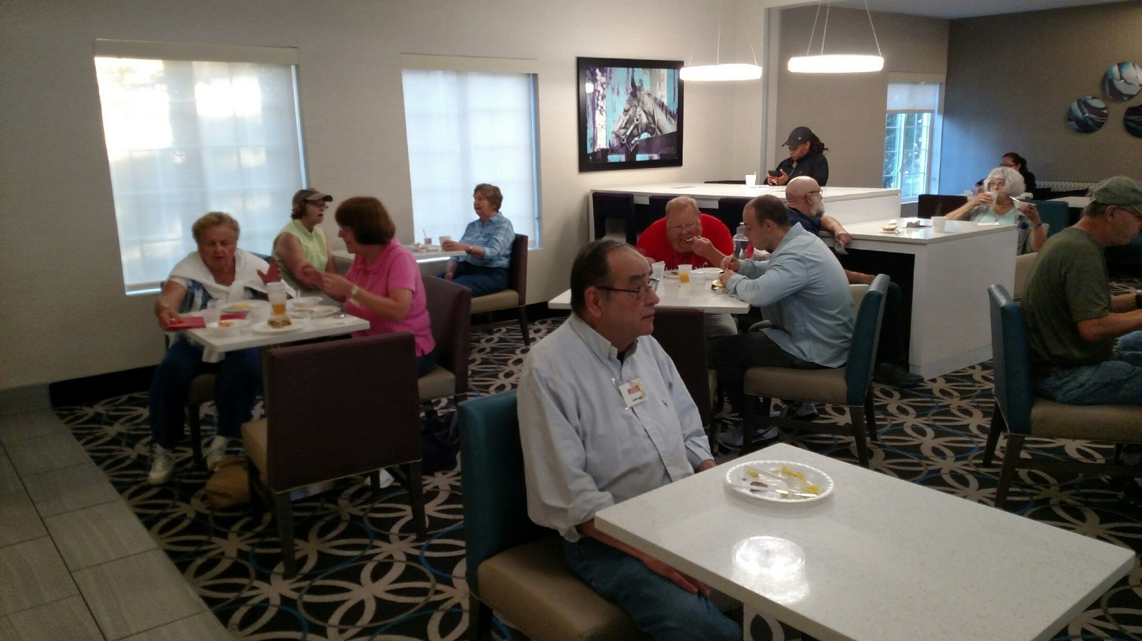
June 14, Day Two
On Thursday morning after breakfast at the La Quinta Inn, the group traveled to the Angel Mound site in Indiana

Slide 2
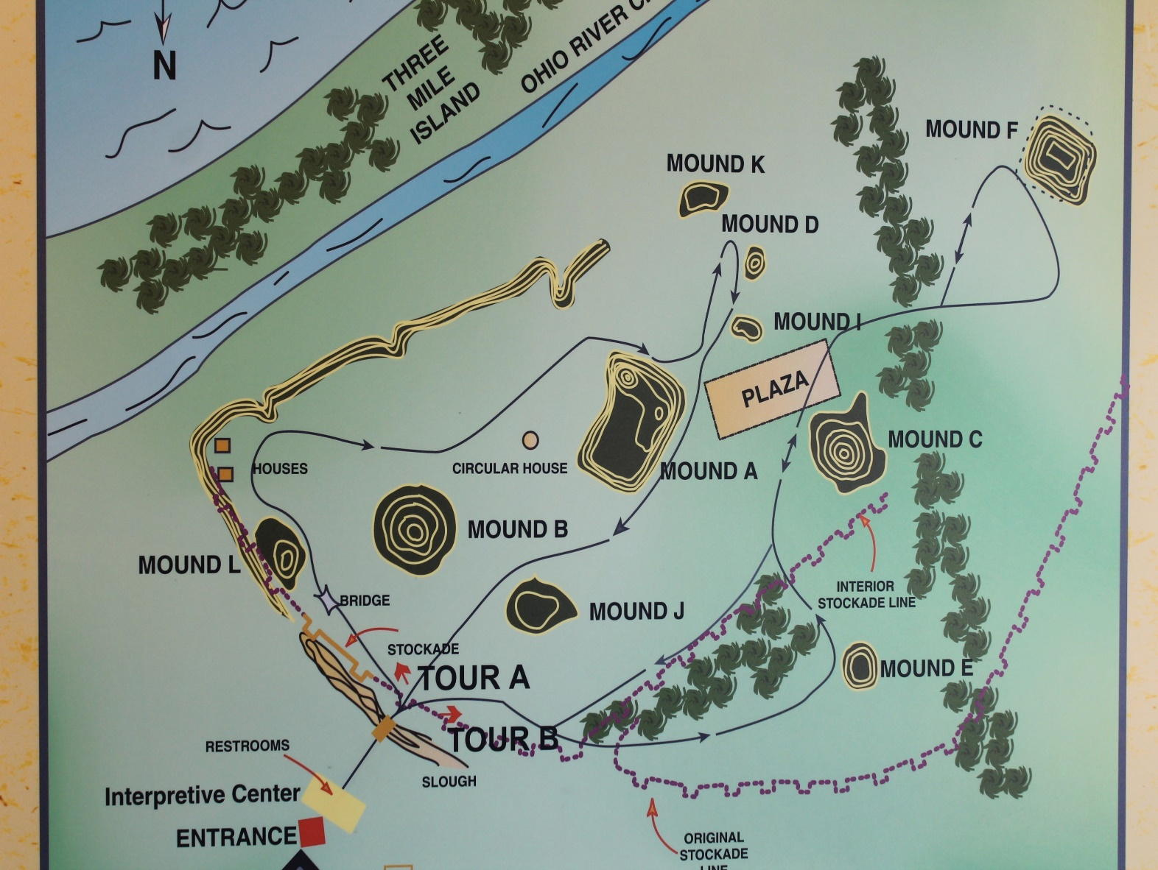
Angel Mounds State Historic Park in Indiana

Slide 3
Group listening to site manager Mike Linderman talk the history of the site (red arrow)

Slide 4
Pictures of two principal flat-topped mounds at Angel
Chief’s Platform Mound
Temple Mound

Slide 5
Member of group climbing the ramp leading to the top of the chief’s mound and a picture of WPA excavations at the site

Slide 6
Group Picture at Angel Mounds

Slide 7
Our next stop was the Kincaid Mounds State Historic Site, where we met Dr. Brian Butler, who led the group on a tour of this significant Mississippian site.

Slide 8
Dr. Butler discussing the history of the site
Observation platform of main mound group

Slide 9
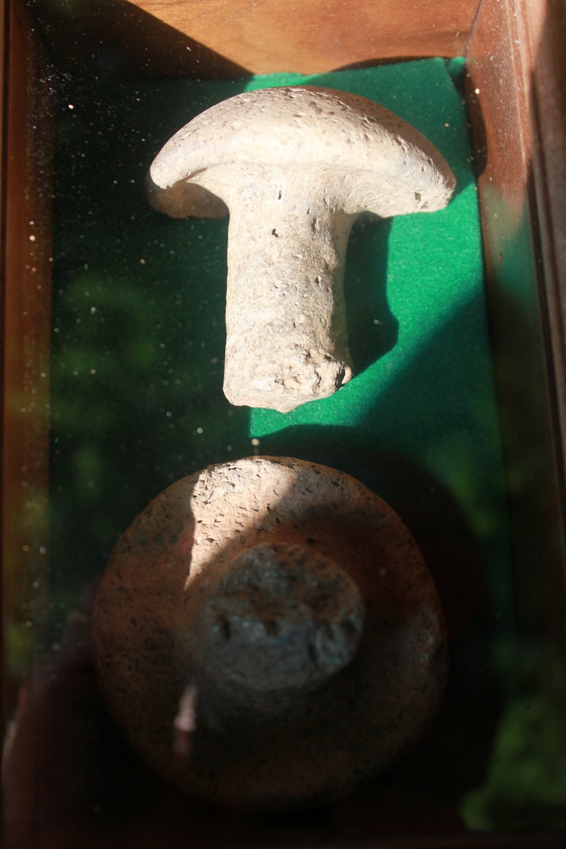
Examples of a potter’s trowel found at the Kincaid site. These are made from shell-tempered clay and are about the size of a door knob.

Slide 10
After leaving the Kincaid site, we traveled to Paducah, Kentucky, to check-in to our hotel and have supper. Unloading and registration was always an experience with 26 people.

